Slide 1

Widrow-Hoff Learning
(LMS Algorithm)
Lei Zhang
http://www.machineilab.org
total 54 pages

Slide 2
ADLINE Network
ADaptive LInear NEuron (ADLINE) network
  Widrow and Hoff – 1960
  One of the most widely used NNs in practical applications
Least Mean Square (LMS) algorithm
total 54 pages

Slide 3
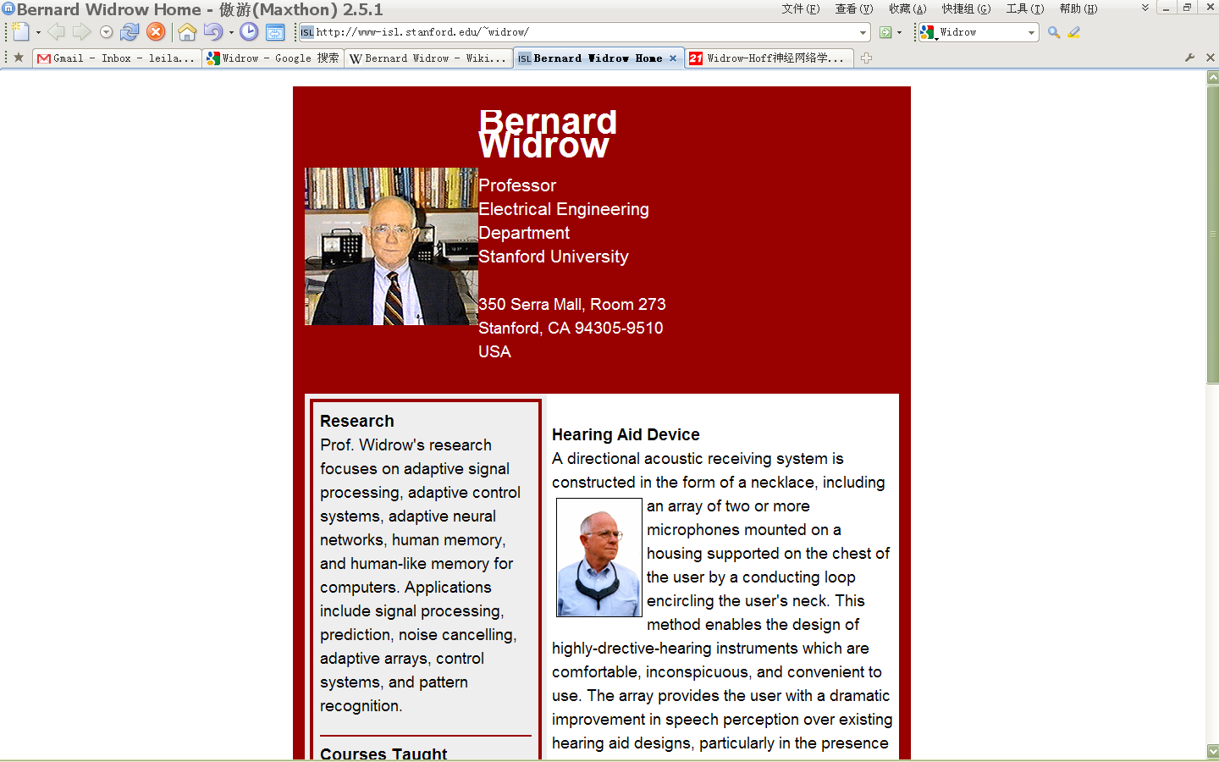
ADLINE Network
late 1950s begin working in NNs
Elected Fellow IEEE, 1976
Elected Fellow AAAS, 1980
IEEE Centennial Medal, 1984
IEEE Alexander Graham Bell Medal, 1986
IEEE Neural Networks Pioneer Medal, 1991
IEEE Signal Processing Society Award, 1999
IEEE Millennium Medal, 2000
Benjamin Franklin Medal, 2001
Adaptive signal processing
Adaptive control systems
Adaptive neural networks
total 54 pages

Slide 4
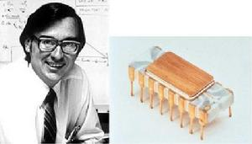
ADLINE Network
微处理器之父
Intel首席科学家
total 54 pages

Slide 5





ADLINE Network
total 54 pages

Slide 6














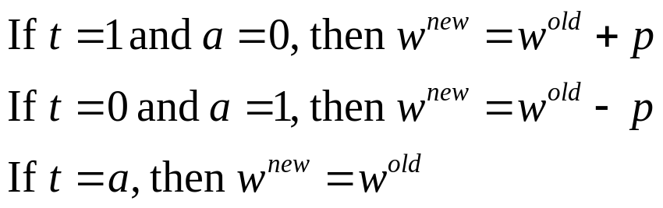







Recall of Perceptron
Learning Rule:
total 54 pages

Slide 7
Recall of Perceptron
Learning Rule:
Decision surface
total 54 pages

Slide 8
Recall of Perceptron
Learning Rule:
Decision surface
The resulting network can be sensitive to noise.
total 54 pages

Slide 9
Recall of Perceptron
total 54 pages

Slide 10
Recall of Perceptron
total 54 pages

Slide 11


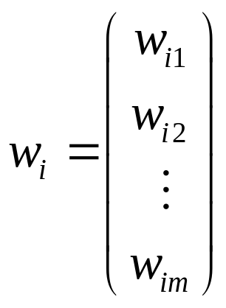
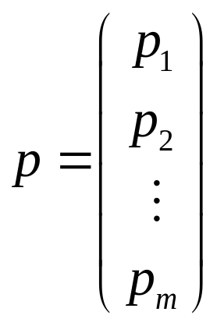

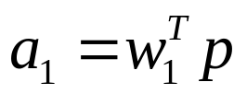
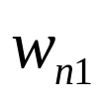

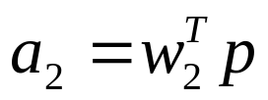


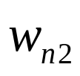
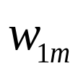
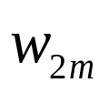
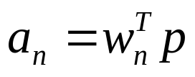
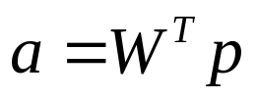
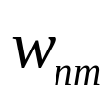

ADALINE Network
total 54 pages

Slide 12
LMS Algorithm
How to update w in order to get the best decision boundary?
total 54 pages

Slide 13


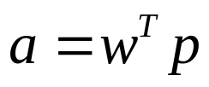

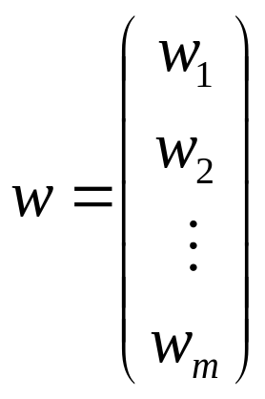

Single Neural
total 54 pages

Slide 14




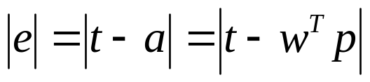
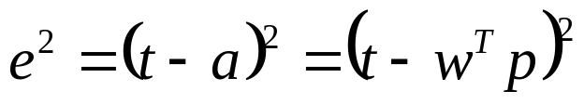
LMS Algorithm
Training Set:
Input:
Target:
Error functions
Object: adjust the weights of the ADALINE in order to minimize the mean square error.
total 54 pages

Slide 15
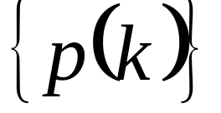

LMS Algorithm
Training Set:
Input:
Target:
Stationary stochastic process
total 54 pages

Slide 16
Mean Square Error
Training Set:
Input:
Target:
Stationary stochastic process
Mean Square Error:
Performance function
total 54 pages

Slide 17
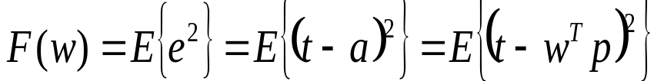
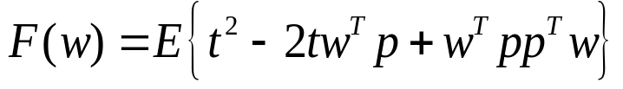

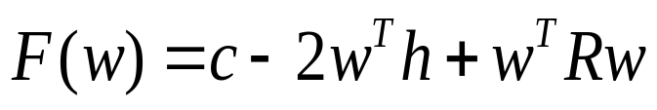


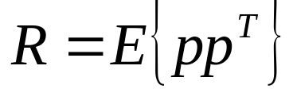
Mean Square Error Analysis
Performance function
correlation matrix
total 54 pages

Slide 18
Mean Square Error Analysis
The mean square error for the ADALINE Network is a
quadratic function:
total 54 pages

Slide 19
Correlation Matrix
Any correlation matrix is a positive semidefinite matrix.
In most practical applications it is a positive definite matrix.
Performance function
total 54 pages

Slide 20
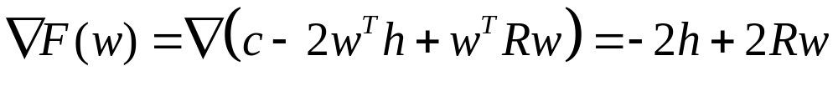


Stationary Point
If R is positive definite:
The correlation matrix R must be at least positive semi-definite. If there are any zero eigenvalues, the performance index will either have a weak minimum or else no stationary point, otherwise there will be a unique global minimum w*.
total 54 pages

Slide 21
LMS Algorithm
Now that we have analyzed our performance index, the next step is to design an algorithm to locate the minimum point.
total 54 pages

Slide 22
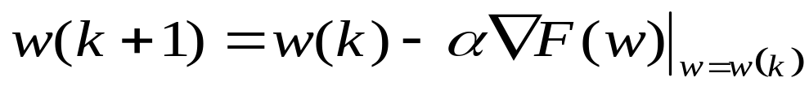
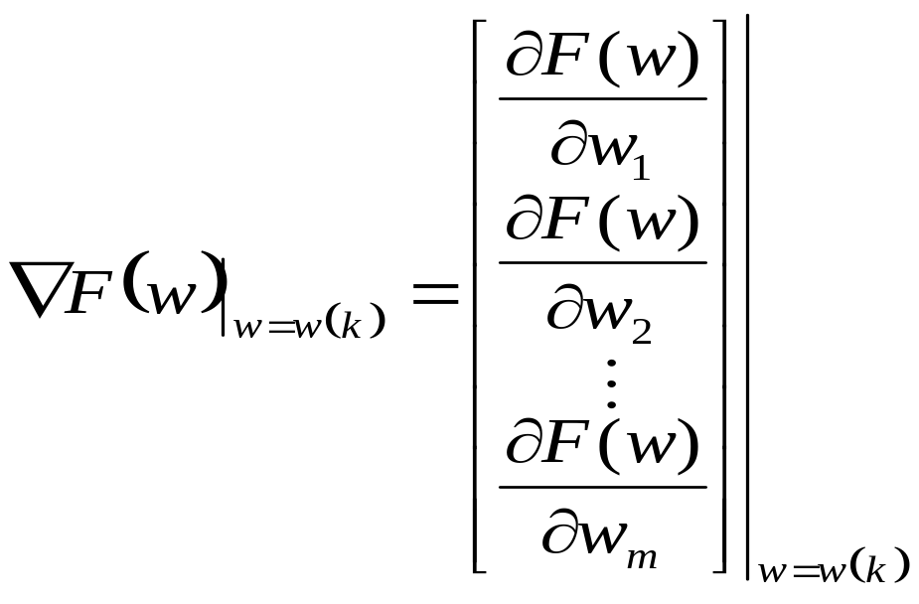

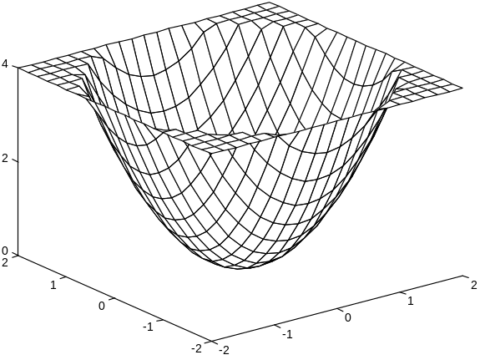
Recall of Steepest Descent Algorithm
total 54 pages

Slide 23
Recall of Steepest Descent Algorithm
total 54 pages

Slide 24
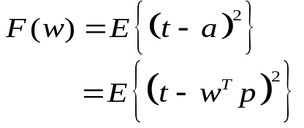
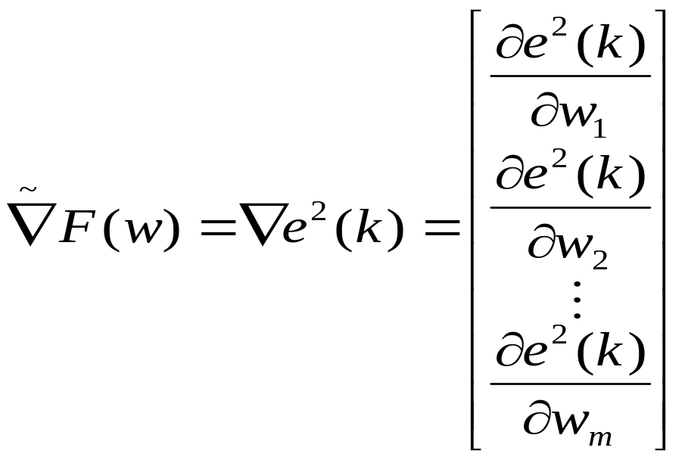
Approximate Steepest Descent
Approximate mean square error (one sample):
Approximate (stochastic) gradient:
total 54 pages

Slide 25
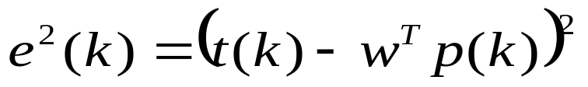
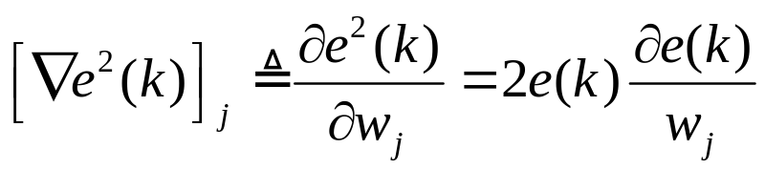
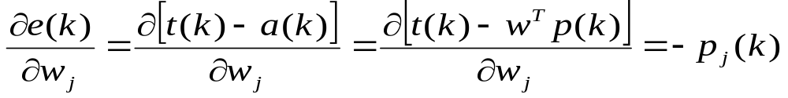
Approximate Gradient Calculation
total 54 pages

Slide 26
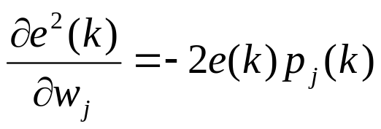
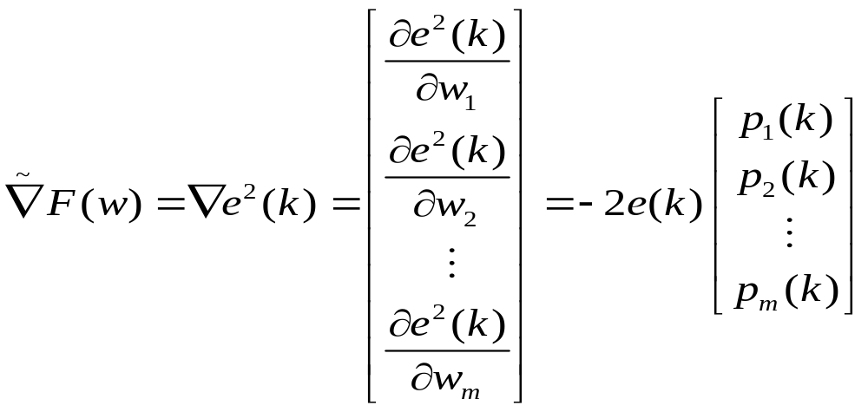
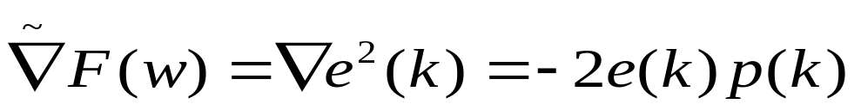
Approximate Gradient Calculation
total 54 pages

Slide 27
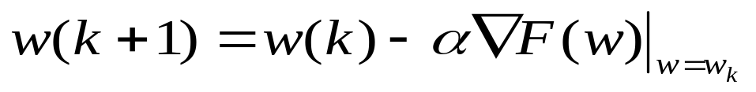

LMS Algorithm
LMS Algorithm:
total 54 pages

Slide 28
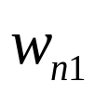
Multiple-Neuron Case
total 54 pages

Slide 29
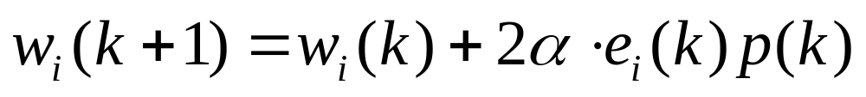
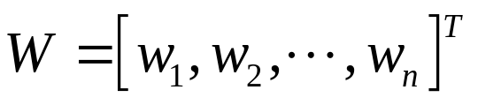

Multiple-Neuron Case
Matrix Form:
total 54 pages

Slide 30
Convergence Analysis
Stochastic system
Deterministic system
total 54 pages

Slide 31
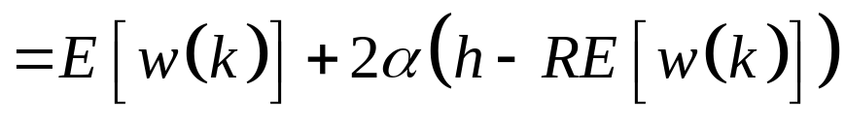
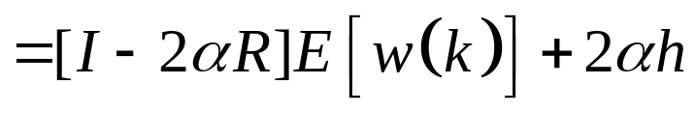
Convergence Analysis
For stability, the eigenvalues of this matrix must fall inside the unit circle.
total 54 pages

Slide 32




Conditions for Stability
(where λ_{i} is an eigenvalue of R)
Since
,
.
Therefore the stability condition simplifies to
1
–
2
α
λ
>
–
i
1
total 54 pages

Slide 33



Steady State Response
If the system is stable, then a steady state condition will be reached.
The solution to this equation is
This is also the strong minimum of the performance index.
total 54 pages

Slide 34
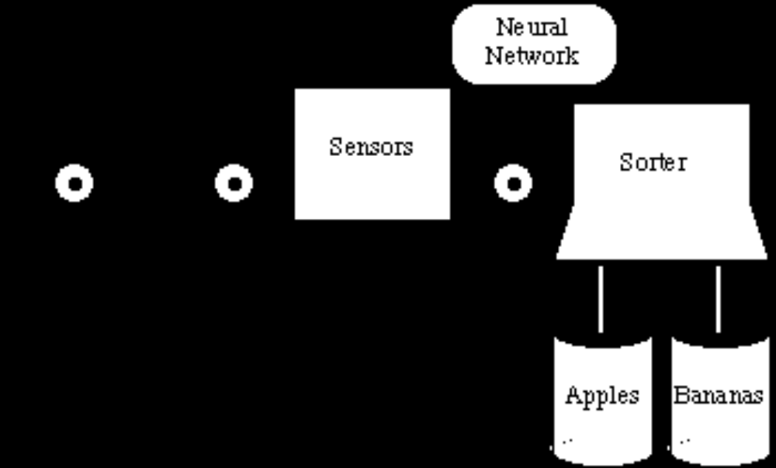

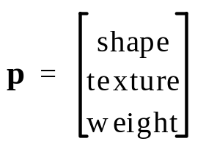



Apple/Banana Classifier
total 54 pages

Slide 35
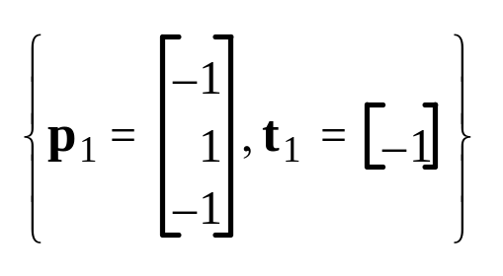
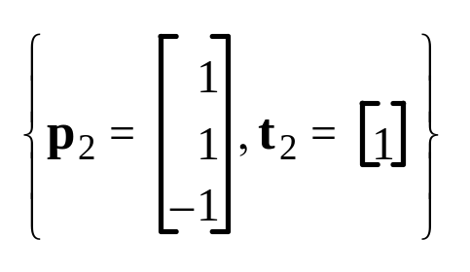


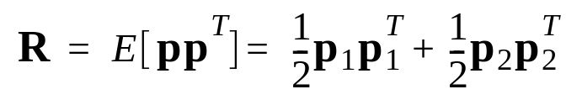
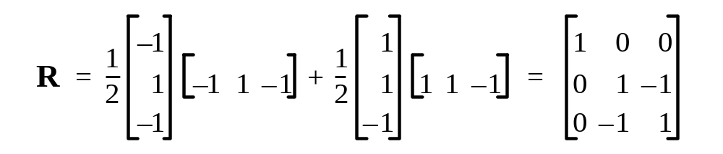
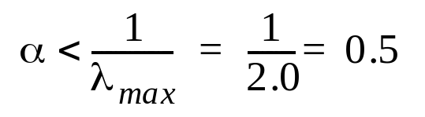

Example
Input vectors are generated randomly with equal probability
total 54 pages

Slide 36

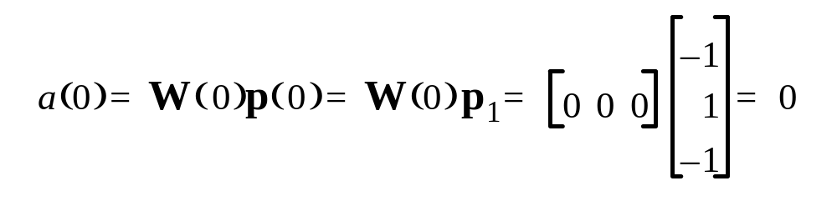

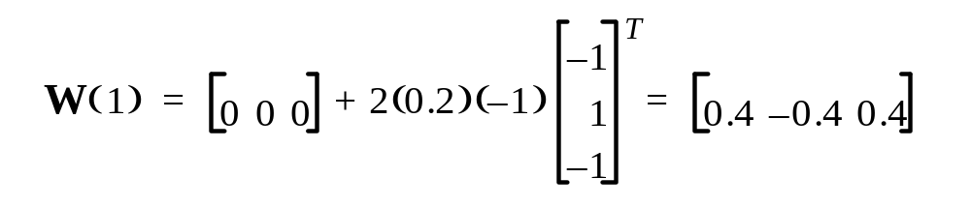
Iteration One
total 54 pages

Slide 37


Iteration Two
total 54 pages

Slide 38


Iteration Three
total 54 pages

Slide 39


Adaptive Filtering
Tapped Delay Line
Adaptive Filter
  -finite impulse response filter
total 54 pages

Slide 40








Adaptive Filtering
B. Widrow and S. D. Stearns, Adaptive Signal Processing, Englewood Cliffs, NJ: Prentice-Hall,1985.
total 54 pages

Slide 41

Example: Noise Cancellation
total 54 pages

Slide 42
















Example: Noise Cancellation
total 54 pages

Slide 43

Example: Noise Cancellation
total 54 pages

Slide 44




Adaptive Filter
total 54 pages

Slide 45

Example: Noise Cancellation
total 54 pages

Slide 46







Correlation Matrix
total 54 pages

Slide 47



Signals
Assume: s is a white random signal uniformly distributed between the values -0.2 and +0.2.
2
π
k
3
⎛
π
m
⎞
(
k
)
=
1.2
sin
-
-
-
-
-
-
-
-
-
–
-
-
-
-
-
⎝
-
3
4
⎠
total 54 pages

Slide 48


Signals
2
2
⎛
π
=
(
⎞
1.2
)
0.5
cos
-
-
-
-
-
-
=
–
⎝
⎠
0.36
3
total 54 pages

Slide 49


Stationary Point
E
[
(
s
(
k
)
+
m
(
k
)
)
v
(
k
)
h
=
]
E
[
(
s
(
k
)
+
m
(
k
)
)
v
(
k
–
1
)
]
0
0
total 54 pages

Slide 50


Stationary Point
E
[
(
s
(
k
)
+
m
(
k
)
)
v
(
k
)
h
=
]
E
[
(
s
(
k
)
+
m
(
k
)
)
v
(
k
–
1
)
]
total 54 pages

Slide 51


Performance Index
Now, what kind of error will we have at the minimum solution?
total 54 pages

Slide 52


Performance Index
total 54 pages

Slide 53


LMS Response
total 54 pages

Slide 54

Echo Cancellation
B. Widrow and R. Winter, “Neural nets for adaptive filtering and adaptive pattern recognition,” IEEE Computer Magazine, March 1988, pp. 25-39
total 54 pages

